Slide 1
Crash test dummies: Lessons from commercial aviation for NLP in the digital humanities
📖
Notes:
Crash test dummies: lessons from commercial aviation for NLP in the digital humanities. [short and simple, 4 slides]
[SLOWLY, CALMLY]
So uh, the digital humanities is generally studying humanist topics, like literature, with digital methods. For this presentation, I‘ll just be talking about computational methods used to study literature, but there’s a lot more than that going on in DH, like 3d scanning. An example of computation in DH is the case study we did with Jane Austen’s book chapters being torn up. The popular term for this is computational literary analysis, and uh, I’ll just shorten it to CLA.
Uh, just note that CLA isn’t computational linguistics. It’s pretty related, but we’re less interested in the mechanics of the language and more about how the language affects the literature.

Slide 2
The current state of CLA research (example from Shakespeare studies)
Sentiment analysis of Macbeth
Sentiment analysis
of King Lear
Sentiment Analysis
of Romeo and Juliet
Sentiment analysis of Romeo and Juliet
Sentiment analysis of Macbeth
Sentiment analysis of King Lear
CLA projects that converse well with each other (ideal)
…
…
Notes:
I recently did some background research for a literature review about how NLP is used in J.R.R. Tolkien studies and Shakespeare studies. J.R.R. Tolkien was an English author, but he was also a linguist, so many scholars who study his work use computational humanities methods, namely, NLP. What I found is that the digital humanities has little agreement on what is a “standard method” or “standard methods” of performing computational literary analysis, and that nearly everyone’s research has huge methodological holes in it because there are no standards. Also, it is moderately rare for computational literary studies to feed off each other and push the field forward, simply because the methodologies don’t fit together like a well-designed puzzle. (Click animation). Here’s an example of how messy it looks in Shakespeare studies. (Click animation). Here’s how it might look if there was a bit more agreement on standardization.
The same problem used to occur in commercial aviation – a specific example is the air traffic control radio. Until the 1950s, more or less, there was no standard phraseology for radio communications. Accidents occurred much more often, for unthinkable reasons. Now there is – you have to transmit information in a particular order in a particular vocabulary to prevent miscommunication. Also, it really sucked when English wasn’t the official language of communications.
So the common areas between commercial aviation and computational literary analysis really boils down to two factors: (next slide)

Slide 3
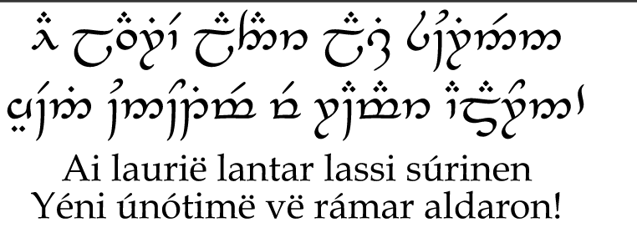
2 Major transferable Lessons
 | Aviation | DH research
Standard operating procedures (SOPs) | Mechanics, pilots follow exact same procedure each time they perform x function, using standard checklists. | Same set of checkpoints to look for unwanted bias in both input (raw data) and output (model)
Rigorous documentation | Mechanic logbooks (books for each airframe), FAA documentation after accidents | Make it a field standard to share all code, all metadata (esp. XML TEI) documentation, and as much source data as possible (raw data, e.g. Jane Austen manuscripts). Also, datasheets.
Notes:
The two factors are SOPs and rigorous documentation/datasheets for datasets. In the DH specific field I observed, Tolkien studies, there was no standardized procedure, and no rigorous documentation of materials used and methodologies, which means we can’t learn from previous accidents (or sucesses), especially ones with many technical steps to follow, like a checklist.
How can we transfer some lessons learned from aviation?
Here’s an overview of the two transferable lessons. We have to be careful when comparing though, and consider what the motivation is for each lesson. We can’t expect to have the exact same needs in both fields, so the motivation for these transferrable lessons are a bit different.
For SOPs, a good example is takeoff or landing. A pilot working in any major airline will have company-issued guidelines, usually based on the FAA (Flight Administration America) guidelines, on how to do everything: when to flick which switch, when to file what paperwork, v.v. The SOPs vary depending on the type of aircraft, how old it is, v.v., so it’s not always a “one thing fits all airplanes” solution. I think this lesson can carry over pretty well to CLA, where we can have a checklist of when we need to set up checkpoints in the experimental process. For example, in a project where we’re creating a natural language model, we should already have an idea of what the industry/research standard for WHEN and HOW to look for biases in the INPUT and OUTPUT. For Tolkien studies, a good example is preprocessing checkpoints, and Hvitfeldt’s textbook mentions this in the beginning too. Accented letters turn up A LOT in Tolkien [click.] Uh, here’s some accented lyrics from a song cycle called Enyalie. Plus, there are invented words that won’t show up in a sentiment lexicon like BING or AFINN. The researcher has to make sure that they account for this in preprocessing, every single time they do any CLA with Tolkien. Documenting that will make sure that other researchers will follow the same steps, since they’re working with the same technically challenging data.
Checklists also should be dynamic, changing over time by regulating or advising committees to update research standards when new potential weaknesses in the wider research is found. We don’t want 3 different projects to encounter the same tripfall, when projects 2 and 3 could have learned from the major failure that project 1 already faced. Lives aren't necessarily immediately at stake in CLA, like it is in commercial aviation, but there are still huge considerations to be made.

Slide 4

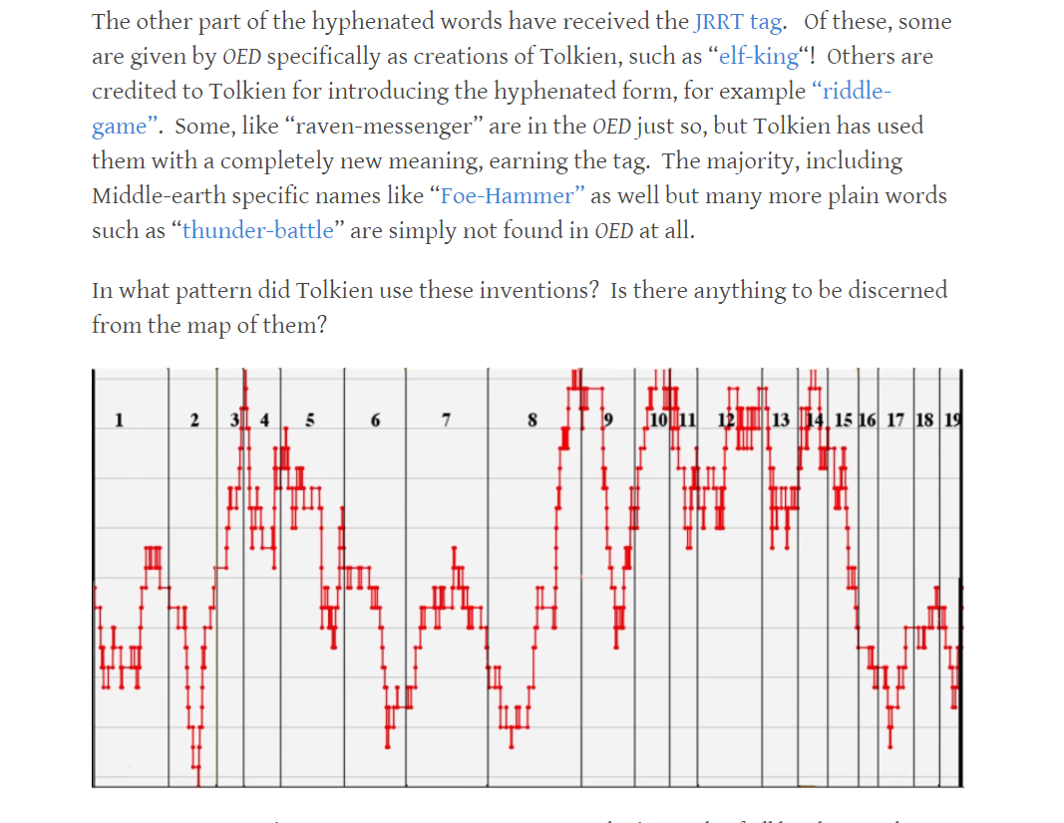
Specific “bad” example from Tolkien studies
Improving it with the lessons we suggested
Notes:
A specific bad example from Tolkien studies is from the project called Wordsthatyouweresaying. Um, this person is a professional colleague of mine, so I’ll be careful about how I tread toes here. Laurie Alden is using on a bunch of computational methods on The Hobbit, and her results are all on this website, but her datasheets are on this single PDF file that is super messy…. I managed to find it once but now I can’t find it again. It’s somewhere there.
Also, all of her results are written up in blog posts, which I guess is OK for the general public, but as an academic trying to retrace her steps, it’s incredibly annoying to try to figure out where her code is.
So how can it improve from here, using the two lessons we identified? Well, the first one, have SOPs, is a bit hard since there’s only a handful of people doing this research at the moment, excluding me, so there’s no real reason for SOPs yet. But it’s still something to keep in mind while the research expands. The second lesson, uh, rigorous documentation, can be implemented here as datasheets, possibly attached to each blog post. Better yet, since this is part of her MA thesis work, it would be nice to look at the MA paper and see links to datasheets for each analysis that she does.

Slide 5

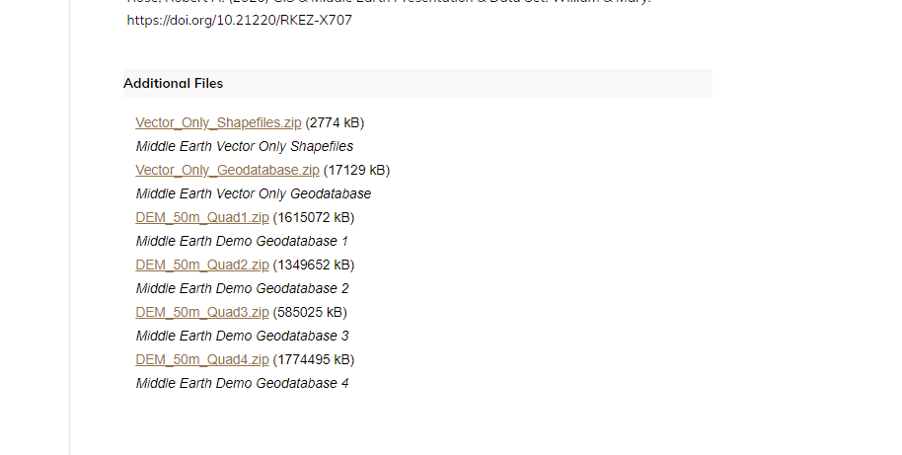
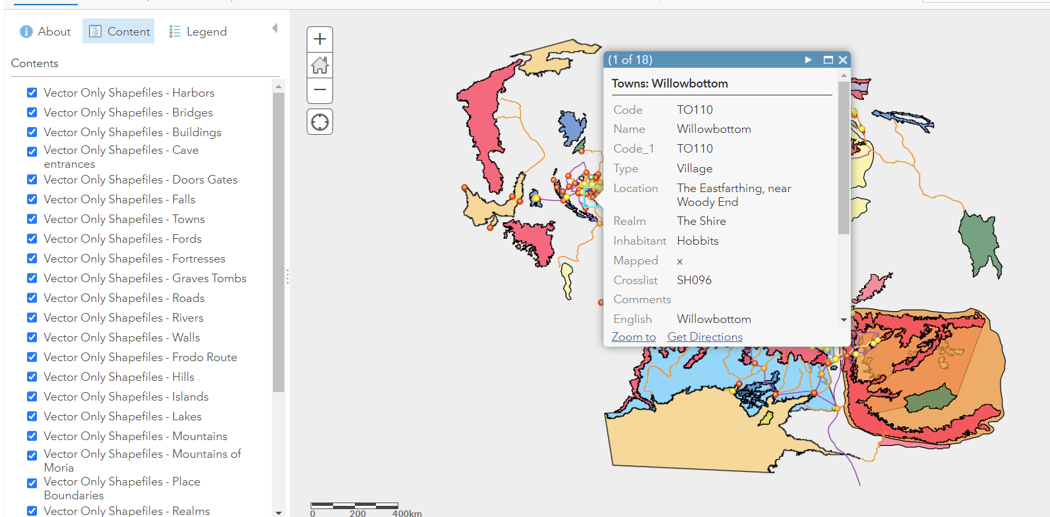
Other DH projects (not computational literary analysis) that already got the memo
Seriously, why can’t CLA researchers get it right?
Notes:
Here’s a “good example.” This project is a GIS (geographic information system) map of Middle-Earth, um, and you can download the dataset (The GIS) along with the datasheet. The datasheet is a PDF you can grab at the download box that I’ve outlined in red, the GIS files are (click) at the bottom of the page.
So uh, other DH researchers who aren’t doing CLA are getting the memo – include datasheets with your datasets. Seriously, why can’t CLA researchers get it right? Hahaa.

Slide 6
Sources Used
Gebru, T., Morgenstern, J., Vecchione, B., Vaughan, J. W., Wallach, H., DauméIII, H., & Crawford, K. (2018). Datasheets for Datasets.
Kuhn, J. (2019). Computational text analysis within the Humanities: How to combine working practices from the contributing fields? Language Resources and Evaluation, 53(4), 565–602. https://doi.org/10.1007/s10579-019-09459-3
Sources of Interest
Why checklists are essential in aviation
shorturl.at/efFG0
Assessing damage of drone collisions (methodology) by the Canadian Aeronautics and Space Institute shorturl.at/grLSU
Mallorn, journal of the Tolkien Society, includes linguistics and literary computation
shorturl.at/cvzUX
Notes:
OK, that’s it for now. Just those two major lessons and those two examples.
Any questions?
For the Kuhn resource: But granted the cultural divide, it is surprising that is so hard to overcome this obstacle that after many years, there is still no best-practice recipe for teams of interdisciplinary collaborators to follow.
For more: my current article is under revision for the peer-reviewed journal Mallorn, uh, which is published by the Tolkien Society… I expect it will be printed for Winter 2022 though, so that’s quite far away. If you’re keen on seeing CLA merge with fantasy studies, that’s the place to go.
If time permits, discuss the various types of tools used right now in CLA that really needs centralization: CLARIN, Voyant, Gale Digital Literary Lab, …
If time permits, show slide of those tools from your other ppt from Oxonmoot 2022

